Slide 1
Iot enabled Home Automation System
Submitted in the partial fulfillment for the award of the degree of
BACHELOR OF ENGINEERING
IN
CSE with specialization in IOT
Submitted by:
Baby Monal (21BCS4526)
Sehajpreet Kaur (21BCS4518)
Under the Supervision of:
Ms. Amanpreet Kaur
Department of AIT-CSE
DISCOVER . LEARN . EMPOWER

Slide 2
Outline
Introduction to Project
Problem Formulation
Objectives of the work
Methodology used
Results and Outputs
Conclusion
Future Scope
References

Slide 3
Introduction to Project
Rapid Growth and Advancement: The concept of smart home automation has evolved significantly from basic appliance control to complex, interconnected systems powered by the Internet of Things (IoT). This shift enhances convenience, security, and energy efficiency in modern homes.
Comparative Analysis: This study provides an in-depth comparison between Proteus and Workwi, popular platforms for home automation, evaluating their components, integration processes, strengths, and limitations to understand their real-world effectiveness.
Future Implications: By examining emerging trends, this paper also identifies potential advancements in smart home automation, focusing on system functionality, accessibility, and data security, with prospects for future research in this rapidly advancing field​.

Slide 4
Problem Formulation
Challenge Identification: Identifying the need for improved efficiency, security, and control in home environments through automation.
Scope Definition: Defining the boundaries of an IoT-enabled home automation system that operates with minimal human intervention.
Goal Setting: Aiming to enhance user convenience and energy management while ensuring system scalability and integration.

Slide 5
Objectives of the Work
Automated Control: To develop a system that automates lighting, temperature, and security based on environmental conditions.
Energy Efficiency: To reduce energy consumption by optimizing appliance usage.
User Interface: To provide a user-friendly interface for seamless control and monitoring of home systems.

Slide 6
Methodology used
Exploring Existing IoT-Based Home Automation Systems: The literature review involves analyzing current research on IoT-based home automation to understand existing functionalities, key technologies, and integration challenges.
Identifying Gaps and Opportunities: By reviewing the literature, potential areas for improvement can be identified.
Networking and Sensor Integration in Proteus: Establishing Sensor Communication and Data Flow: Networking in Proteus involves setting up virtual sensors (such as PIR, temperature, and gas sensors) to communicate with the controller, typically using protocols like MQTT.

Slide 7
Simulating Real-Time Device Interactions: Proteus facilitates realistic simulation of sensor responses to different environmental conditions, enabling the testing of device interactions.
Designing User Interface for Control and Monitoring: Developing a mobile app allows users to monitor and control devices remotely.
Implementing IoT Connectivity and Automation Control: The app acts as a bridge between the user and the IoT system, sending commands to devices and displaying sensor data.

Slide 8
Results and Outputs
Comparative Analysis: The study found that both Proteus and Workwi technologies offer unique advantages in home automation, with Proteus excelling in user interface design and Workwi in energy management capabilities
Security Vulnerabilities: The research identified critical security vulnerabilities in current systems, highlighting the need for improved encryption methods and user authentication processes to mitigate risks associated with unauthorized access and cyber threats
Real-Time Monitoring: The integration of Blynk Cloud and Proteus simulation demonstrated effective real-time monitoring and control of household appliances, enhancing user engagement and energy conservation efforts.

Slide 9
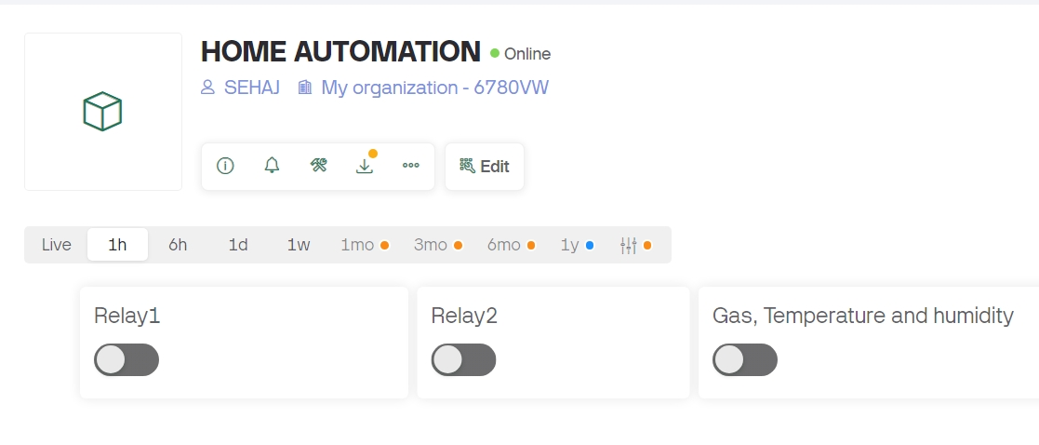
System Reliability: The successful implementation of MQTT connections in the Blynk simulation underscored the system's reliability in automating home tasks and providing robust security measures, ensuring consistent performance in smart home environments.

Slide 10
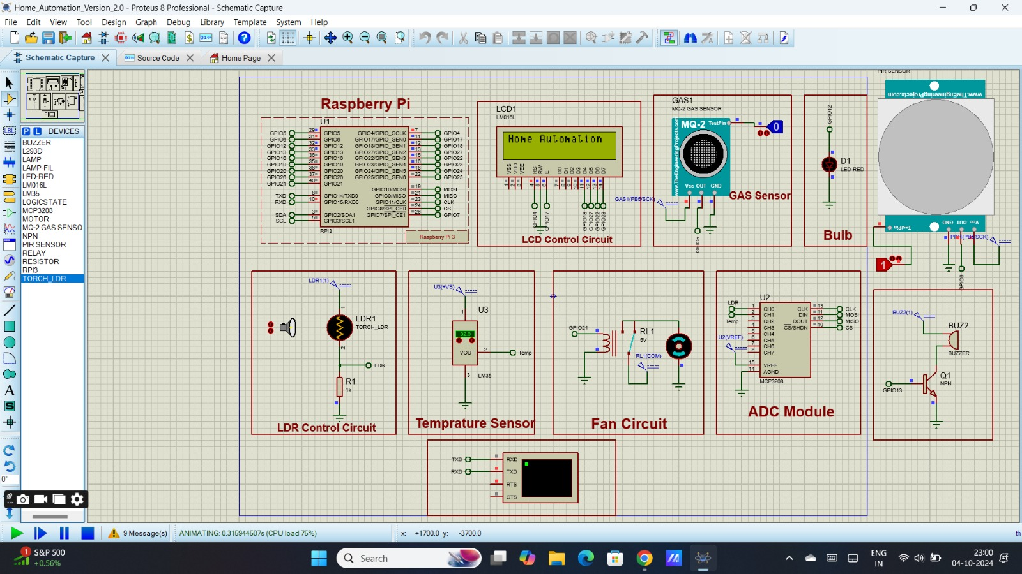

Slide 11
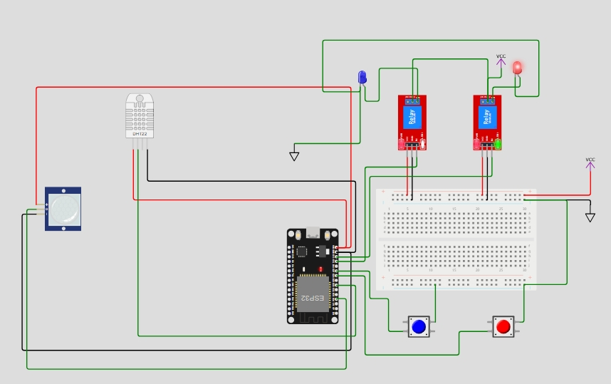

Slide 12
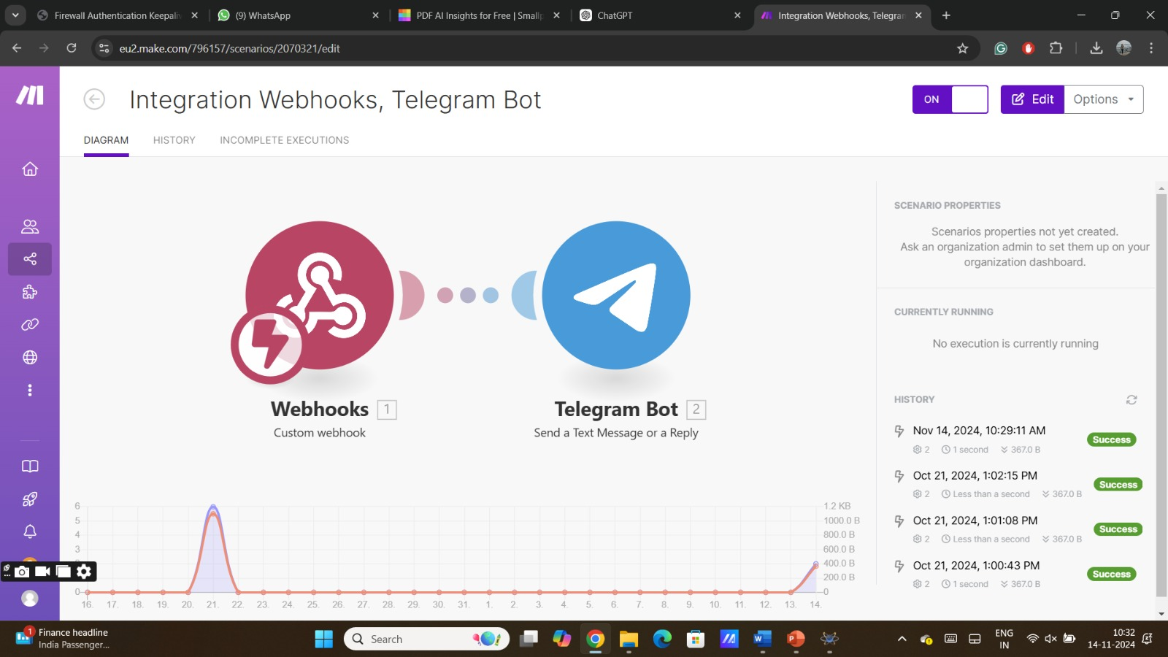

Slide 13
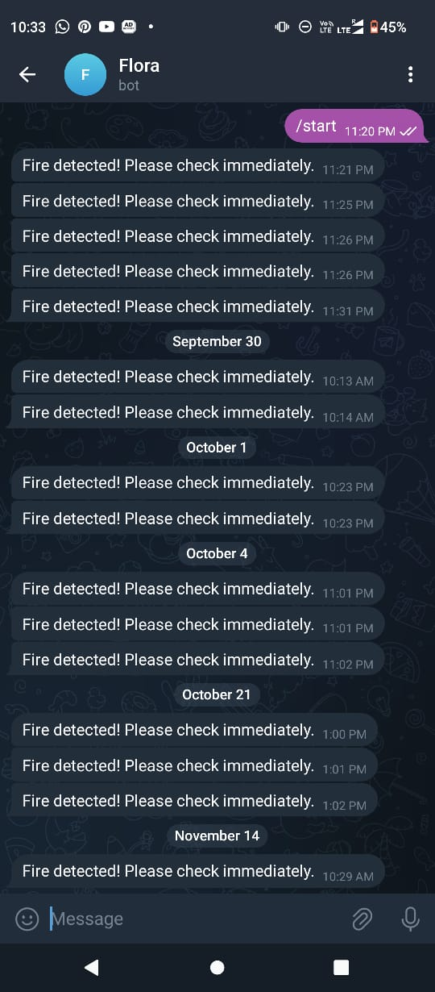

Slide 14
Conclusion
Technological Advancements: The integration of IoT technologies significantly enhances home automation, improving security, energy efficiency, and user convenience through advanced sensors and control systems.
Challenges and Opportunities: While smart home systems present numerous advantages, challenges such as data privacy, interoperability, and installation complexity must be addressed to facilitate broader consumer adoption.
Future Directions: Continued research and development in machine learning, decentralized authentication, and user-friendly interfaces are essential for advancing smart home automation and ensuring robust security measures.

Slide 15
Future Scope
Enhanced Security Measures: Future research should focus on developing advanced security frameworks, including machine learning for threat detection and decentralized authentication, to protect user data in smart home networks.
Interoperability Solutions: There is a need for standardized protocols and systems that ensure seamless integration and communication between various smart home devices from different manufacturers, enhancing user experience and functionality.
AI and Predictive Maintenance: Investigating the application of AI-driven predictive maintenance for smart appliances can lead to proactive problem identification, reducing downtime and maintenance costs while improving overall efficiency in smart home systems.

Slide 16
References
R. Sarmah, M. Bhuyan and M. H. Bhuyan, "SURE-H: A Secure IoT Enabled Smart Home System," 2019 IEEE 5th World Forum on Internet of Things (WF-IoT), Limerick, Ireland, 2019, pp. 59-63, doi: 10.1109/WF- IoT.2019.8767229.
K. M. Kumar and S. Chaudhury, "Development of a Smart Home Automation System using IoT enabled Devices," 2022 IEEE 19th India Council International Conference (INDICON), Kochi, India, 2022, pp. 1-5, doi: 10.1109/INDICON56171.2022.10040165.
R. Sivapriyan, S. V. Sushmitha, K. Pooja and N. Sakshi, "Analysis of Security Challenges and Issues in IoT Enabled Smart Homes," 2021 IEEE International Conference on Computation System and Information Technology for Sustainable Solutions (CSITSS), Bangalore, India, 2021,pp. 1-6, doi: 10.1109/CSITSS54238.2021.9683324.
H. K. Singh, S. Verma, S. Pal and K. Pandey, "A step towards Home Automation using IOT," 2019 Twelfth International Conference on Contemporary Computing (IC3), Noida, India, 2019, pp. 1-5, doi: 10.1109/IC3.2019.8844945.

Slide 17
[5] H. Durani, M. Sheth, M. Vaghasia and S. Kotech, "Smart Automated Home Application using IoT with Blynk App," 2018 Second International Conference on Inventive Communication and Computational Technologies (ICICCT), Coimbatore, India, 2018, pp. 393-397, doi: 10.1109/ICICCT.2018.8473224.
[6] Tate K, Pawar M. HOME AUTOMATION WITH ANDROID UNDER IOT CONCEPT. IJIERT -
International Journal of Innovations in Engineering Research and Technology. 2016 February 20.
[7] Bohara B, Maharjan S, Shrestha BR. IoT Based Smart Home using Blynk Framework.
[8] D. Pavithra and R. Balakrishnan, "IoT based monitoring and control system for home automation," 2015 Global Conference on Communication Technologies GCCT), Thuckalay, India, 2015, pp. 169-173, doi: 10.1109/GCCT.2015.7342646.

